Slide 1

Exploratory Data Analysis
G2M Insight For Cab Investment Firm
February 8, 2023
Zakaria Arshad

Slide 2

Agenda
Executive Summary/Objective
Approach
Data Information
EDA
EDA Summary + Recommendation

Slide 3
Executive Summary/Background
XYZ is a private equity firm in US. Due to remarkable growth in the Cab Industry in last few years and multiple key players in the market, it is planning for an investment in Cab industry.
Objective: Use data analysis to provide an actionable insight for XYZ to decide on making investment.

Slide 4
Approach/Data Information
Data came in the form of four spreadsheets, in time frame 2016-01-31 to 2018-12-31.
City.csv – 20 rows, 3 columns. Contains information about city, population, and users in city.
Cab_Data.csv – 359392 rows, 7 columns. Contains information about Transaction ID, Date of Travel, Company, City, KM Travelled, Price Charged, and Cost of Trip
Customer_ID.csv - 49171 rows, 4 columns. Contains information about Customer ID, Gender, Age, and Income (USD/Month)
Transaction_ID.csv – 440098 rows, 3 columns. Contains information about Transaction ID, Customer ID, and Payment Mode.

Slide 5
Exploratory Data Analysis

Slide 6
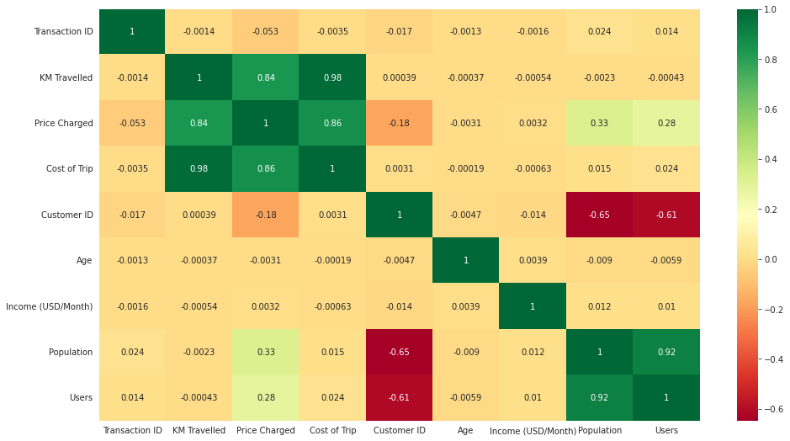
Correlation

Slide 7
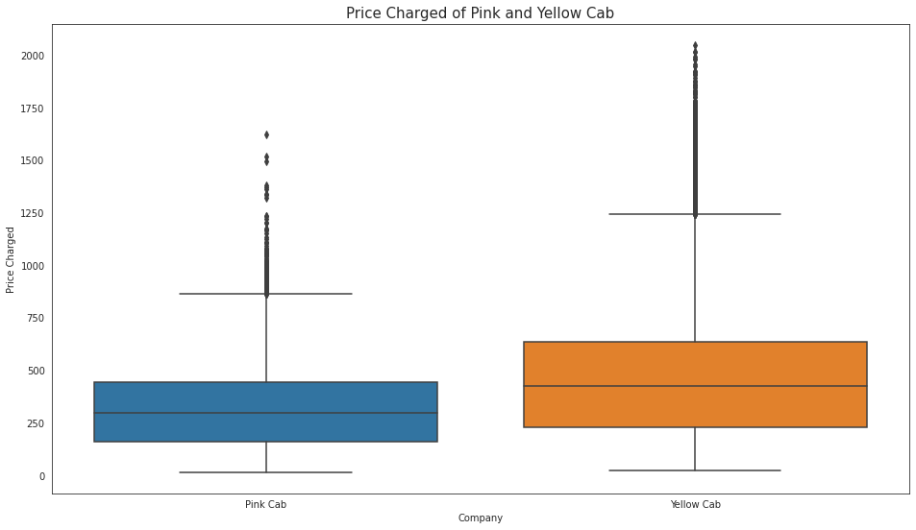
Price Charged

Slide 8
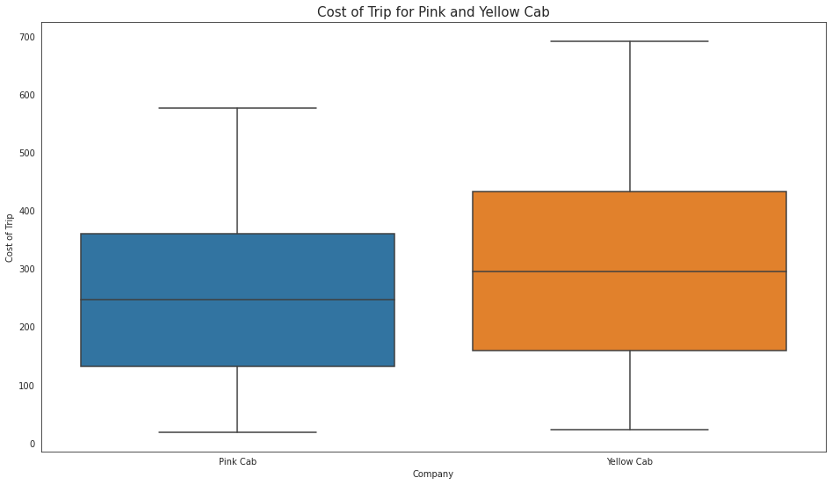
Cost of Trip

Slide 9
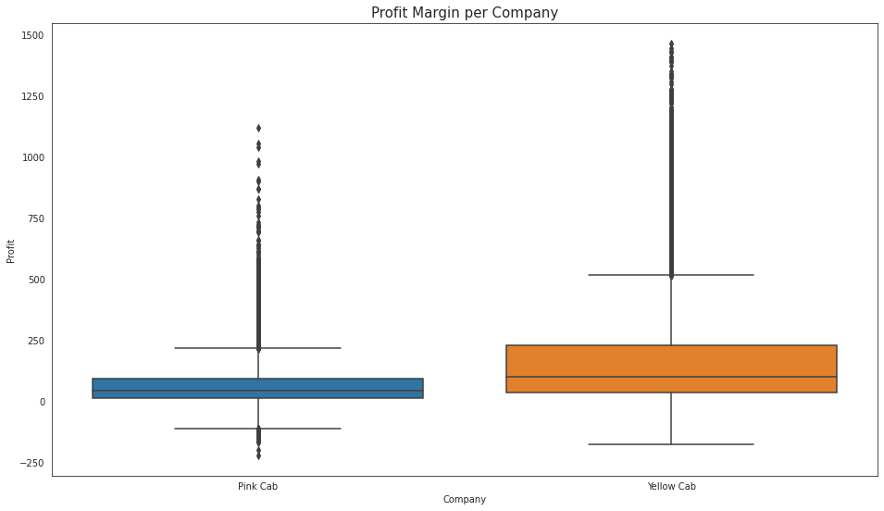
Profit Margin

Slide 10
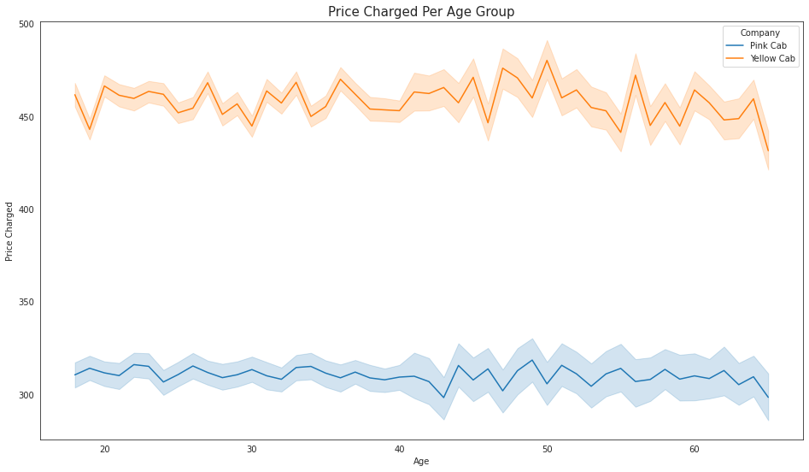
Price Charged Per Age Group

Slide 11
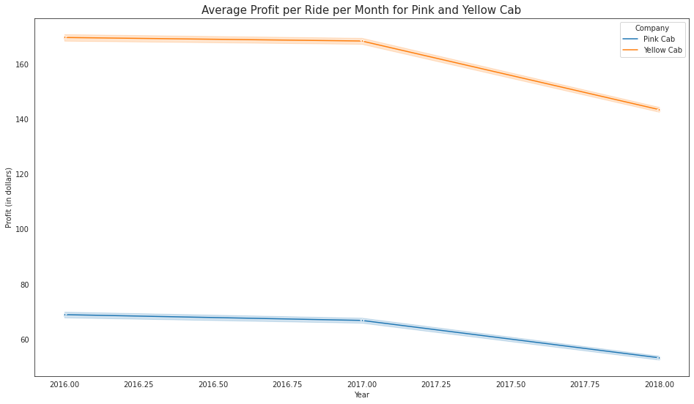
Average Profit per Ride per Month

Slide 12
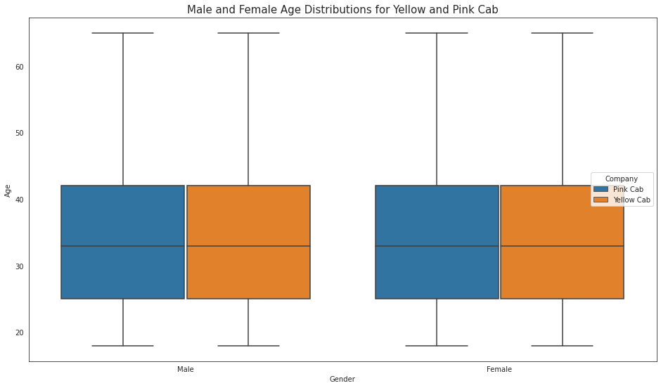
Male and Female Age Distributions

Slide 13
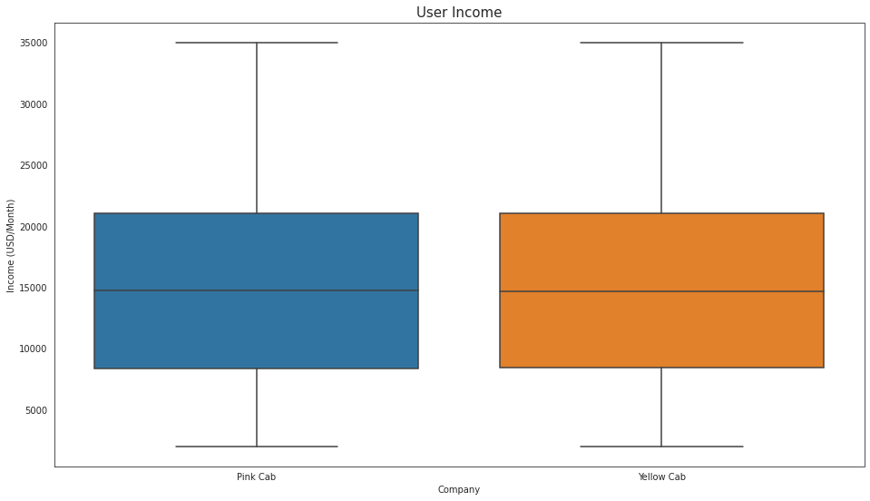
User Income

Slide 14
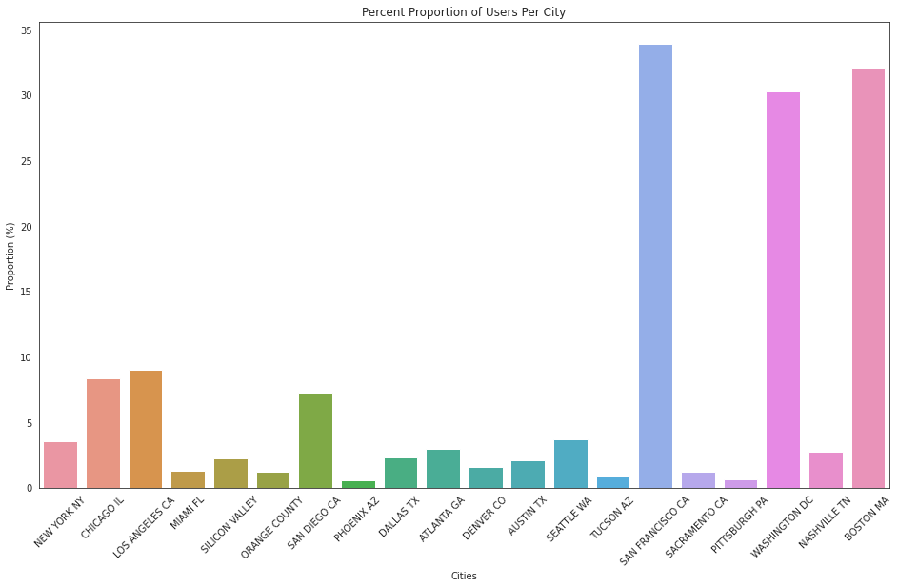
Percent Proportion of Users Per City

Slide 15
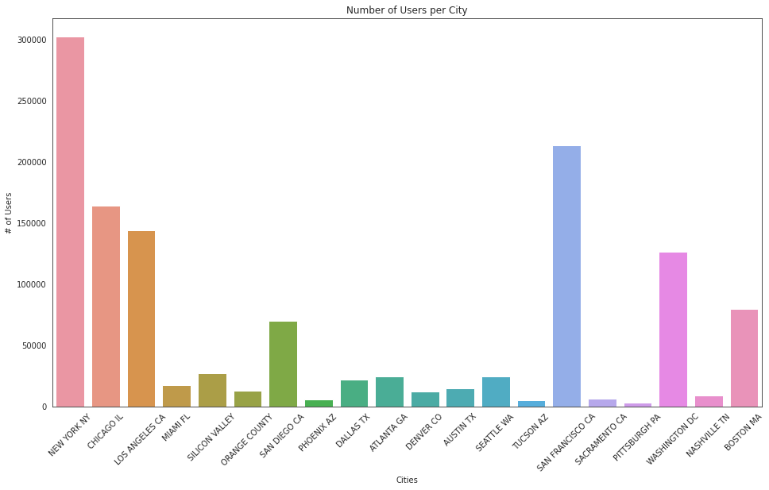
Number of Users per City

Slide 16
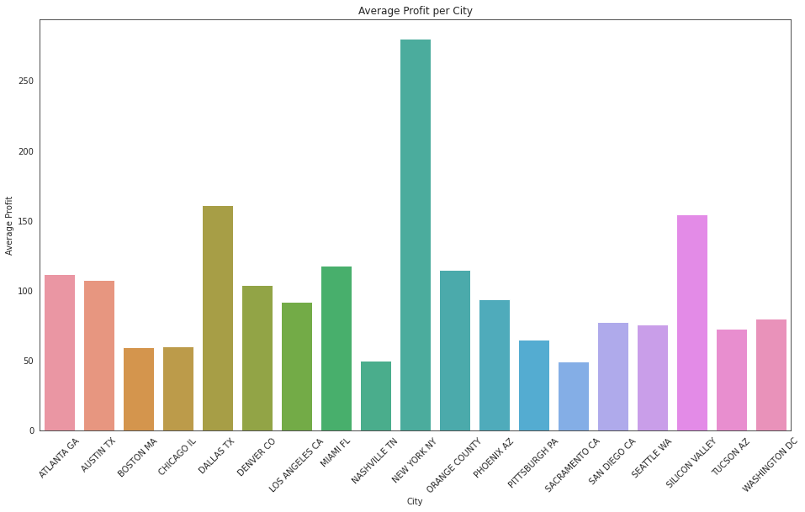
Average Profit per City

Slide 17
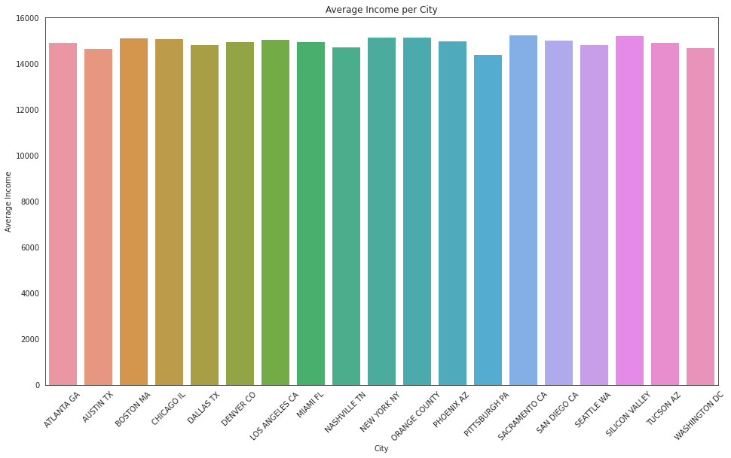
Average Income per City

Slide 18
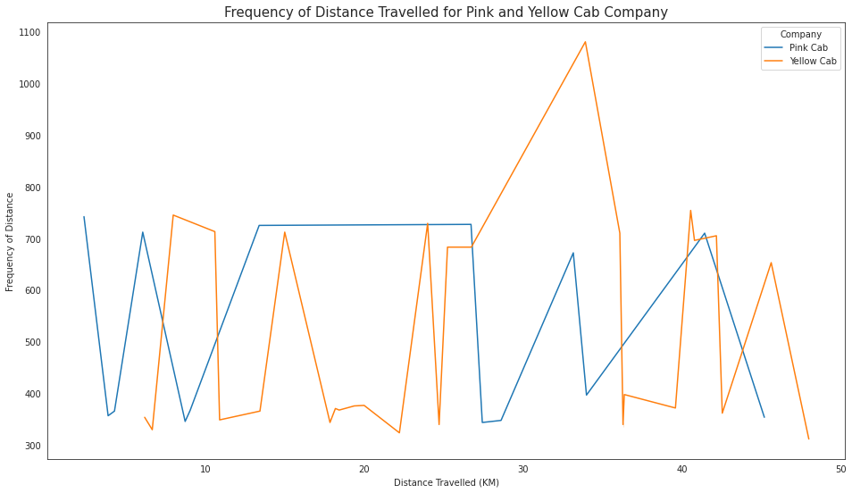
Frequency of Distance Travelled

Slide 19
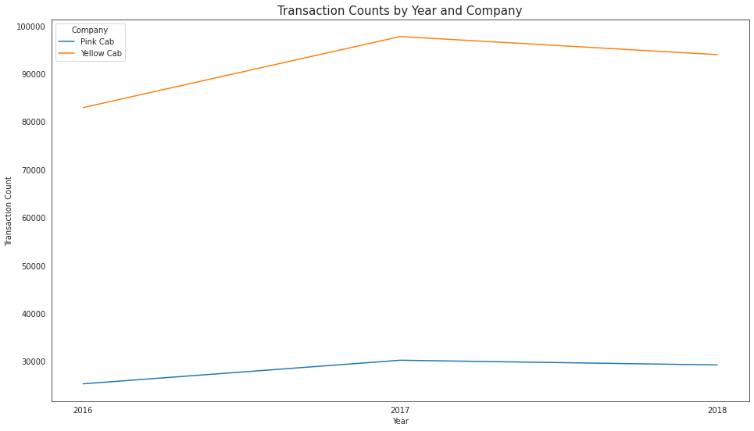
Transaction Counts by Year and Company

Slide 20
Hypothesis Testing

Slide 21
Hypothesis #1: The Yellow Cab is more often used for trips over 25km.
Null Hypothesis: There is not a significant difference in the usage of Yellow Cab compared to Pink Cab for trips over 25km.

Slide 22
Hypothesis #2: The Yellow Cab has a higher average user income
Null Hypothesis: There is no difference in average user income

Slide 23
Hypothesis #3: There is an age group where Yellow Cab is significantly more popular than Pink Cab (and no age groups where Pink Cab is more popular).
Null Hypothesis: Both cabs are equally used across all age groups.
Age groups used: 18, 25, 33 42, 65. This is the minimum, 25%, 50%, 75%, and maximum for age.

Slide 24
Hypothesis #4: There is a significant difference in profit margin for the age groups in Hypothesis 3.
Null Hypothesis: There is no significant difference in profit margin for the age groups in Hypothesis 3.

Slide 25
Hypothesis #5: There a difference in profit margin between genders for the two companies
Null Hypothesis: There is no difference in profit margin between genders for the two companies.

Slide 26
EDA Summary + Recommendation

Slide 27
EDA Summary
Yellow Cab has a higher profit margin than Pink Cab.
Yellow Cab has far more transactions than Pink Cab.
This is true despite Yellow Cab being more expensive per trip!
Yellow Cab has an advantage in users in range 42 to 65.
Yellow Cab and Pink Cab have very similar forecasted falls in profit and transactions.
In most other categories, such as user income, male and female distribution, frequency of distance travelled, etc., Pink Cab and Yellow Cab were very similar.

Slide 28
The recommended investment is Yellow Cab

Slide 29
Thank You!

